Slide 1
CS 447/647
Virtualization

Slide 2
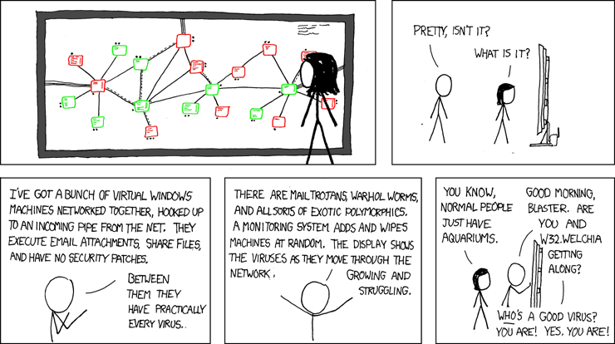
Overview
What is Virtualization?
What is Xen and KVM?
Proxmox
Apptainer (Singularity)
https://xkcd.com/350/

Slide 3
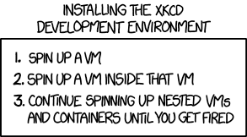

Slide 4
Virtualization
Multiple operating systems concurrently on the same hardware
One Host OS to many Guest OS’s
Big Industry - VMWare Revenue ~$10B
Purchased by Dell
Why?
Flexibility
Efficiency
Backups
Resilience
Security

Slide 5
Virtual Vernacular
Virtualized Hardware
Hypervisors
OS-Level Virtualization
Docker - commercial
lxc - Free
lxd extends it
Singularity - HPC
Windows - Host OS must match
Desktop
Server
Nano Server

Slide 6
Hypervisors
Virtual Machine Manager/Monitor
Software layer between the Guest OS and Hardware
Shares system resources
CPU, RAM, Disk and Network
Isolates* Guest OS’s
https://www.crowdstrike.com/blog/venom-vulnerability-details/
Agnostic
Ubuntu
Windows
FreeBSD
Debian

Slide 7
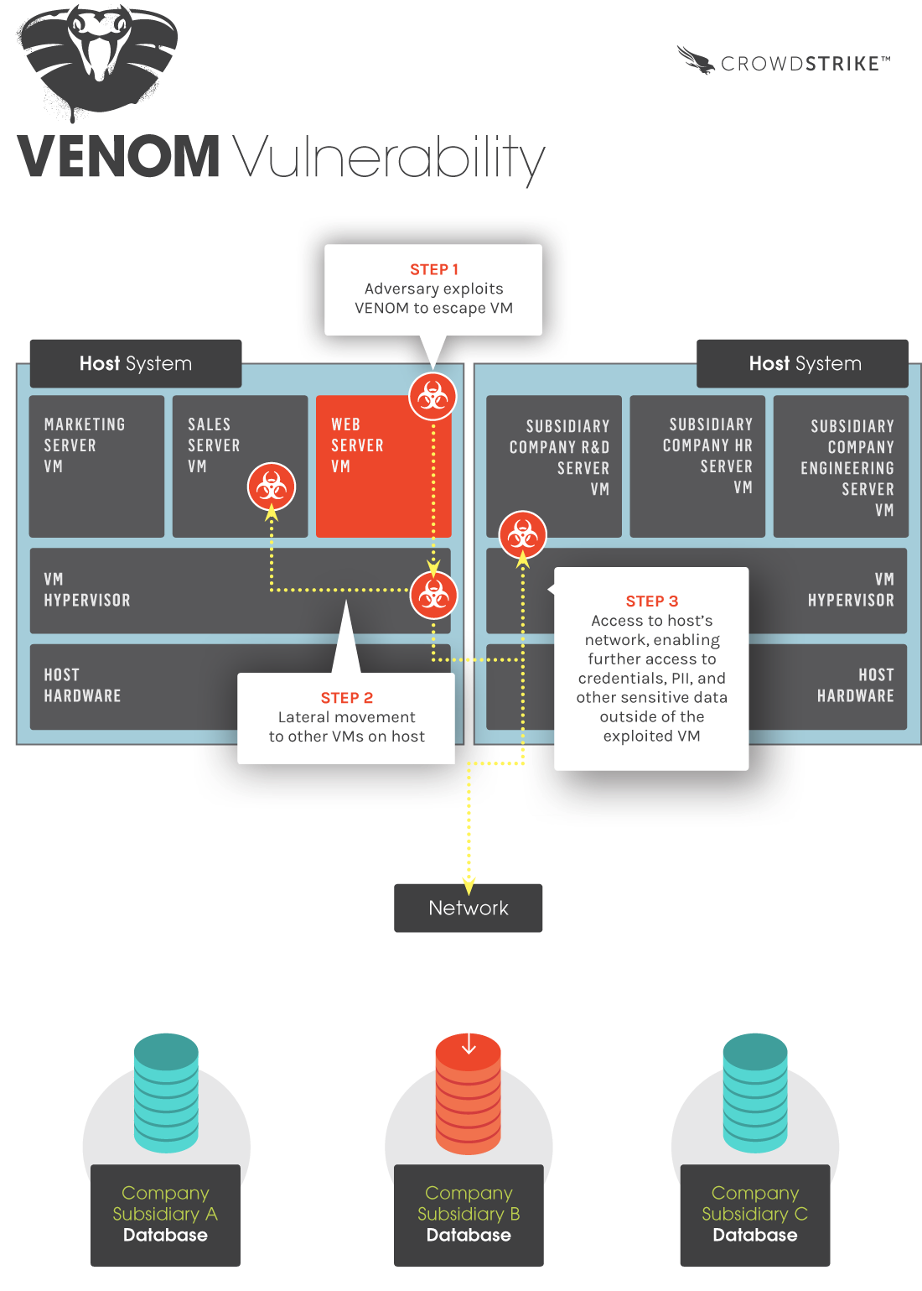

Slide 8
Full Virtualization
Emulates the underlying hardware
qemu-system-x86_64 -machine help
qemu-system-x86_64 -cpu help
Broadwell, Skylake and Pentium I (1993)
Virtual Hardware components
CPU
Hard disks
Ethernet
Interrupts
Motherboard Hardware
Quick EMUlator (QEMU)
Best known Linux Full Virtualization Software
X86, ARM, MIPS, PowerPC

Slide 9
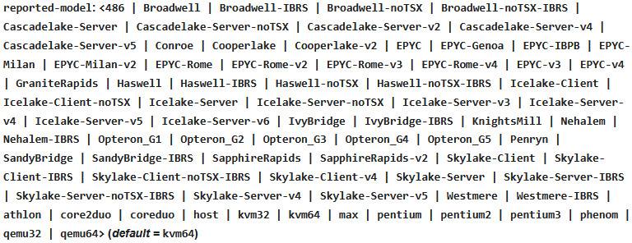
QEMU CPU Types

Slide 10
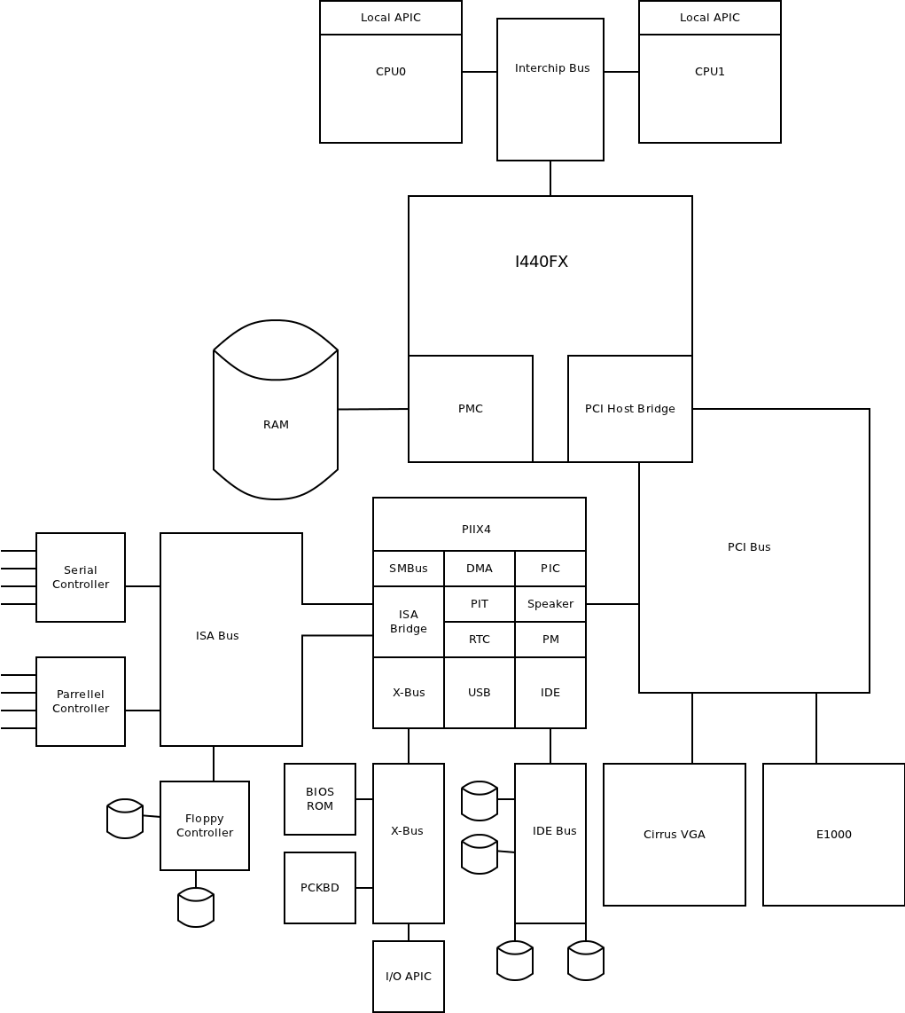
I440FX

Slide 11
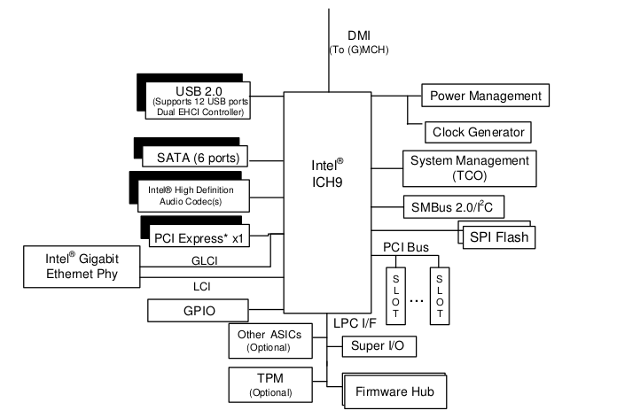
ICH9
Notes:
2007

Slide 12
Paravirtualization (Xen)
Guest OS detects virtualized state
Improved performance (1% - 3% overhead)
Guest OS requires various drivers or kernel modules
No Windows
Needs full hardware virtualization
Notes:
Enlightened VM works with the Host OS.

Slide 13
Hardware-Assisted Virtualization
CPU Feature Based
Intel-V
AMD-V
Accelerated Virtualization
CPU and memory virtualized by hardware
Works with full virtualization and paravirtualization
GPU Virtualization
Nvidia vGPU
Paid licensing
Formerly time-sliced, now SR-IOV
AMD MxGPU
Free, open-source
SR-IOV
No drivers/documentation available to the general public

Slide 14
Paravirtualized Drivers
Enabled by Hardware Assisted Virtualization
Paravirtualized components
Disks
Networking
Graphics Cards
Filesystems - (9p)
Greatly reduces the amount of full virtualization
Performance
e1000 - 600Mb/s
virtio-net - little to no overhead

Slide 15
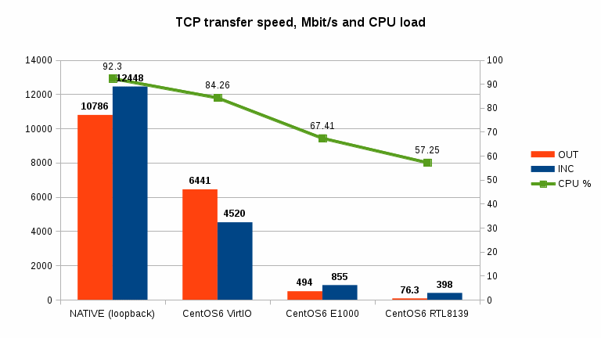

Slide 16
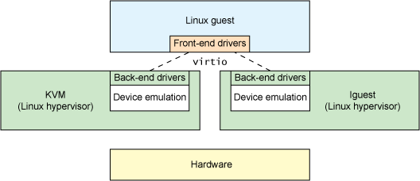
VirtIO
Paravirtualized Drivers

Slide 17
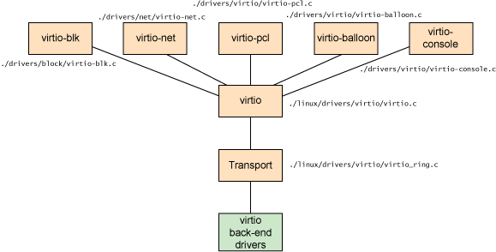
virtio framework

Slide 18
Hypervisors
Type 1 - Runs on hardware without supporting OS
ESXI (Commercial)
XenServer (Commercial)
Proxmox (Free)
Type 2 - User-space applications within an OS
QEMU
Virtualbox
VMWare Player + Workstation

Slide 19
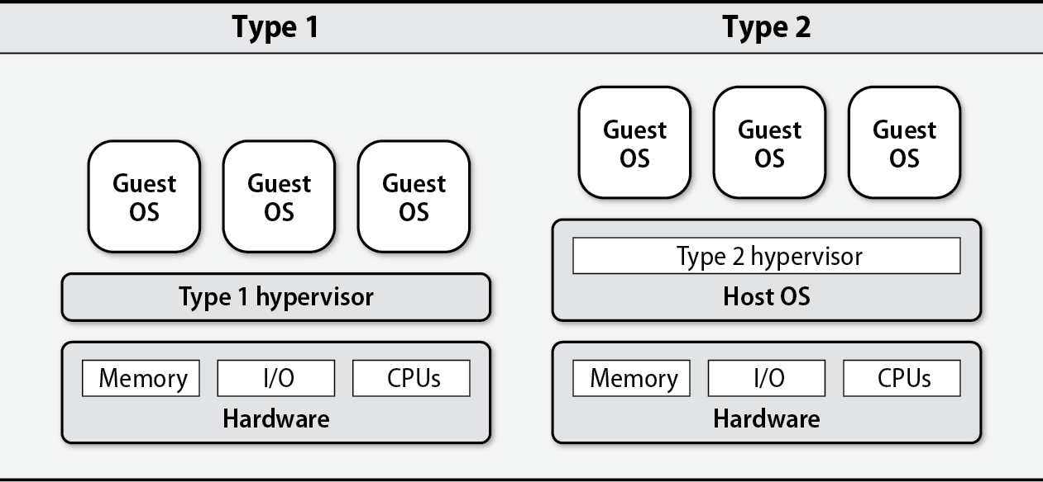

Slide 20
Live Migration
Move a VM between Hypervisors
Real time
Little to no service interruption
Copies memory
Copies disk
DRBD Dual-Master
High-availability, disaster recovery, maintenance

Slide 21
Virtual machine images (disks)
Images
Canned Operating System
File Formats - ova, img, qcow2, raw
Snapshotting
Portable
Metadata
qemu-img create -f qcow2 disk1.img 10G #info, resize

Slide 22
Containerization
OS-level Virtualization
Portable
Isolated
Relies on Kernel Features for isolation
cgroups
tap networking
process namespaces
Cannot access files or resources outside of container.*
Benefits
Performance - low latency IO, near native

Slide 23
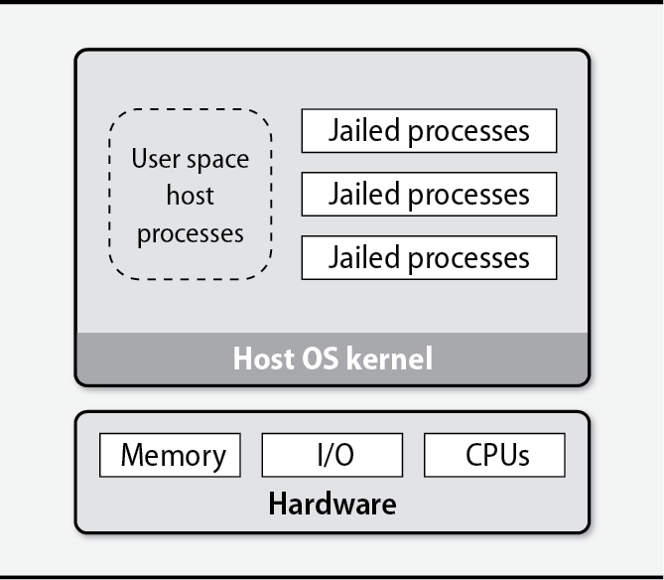

Slide 24
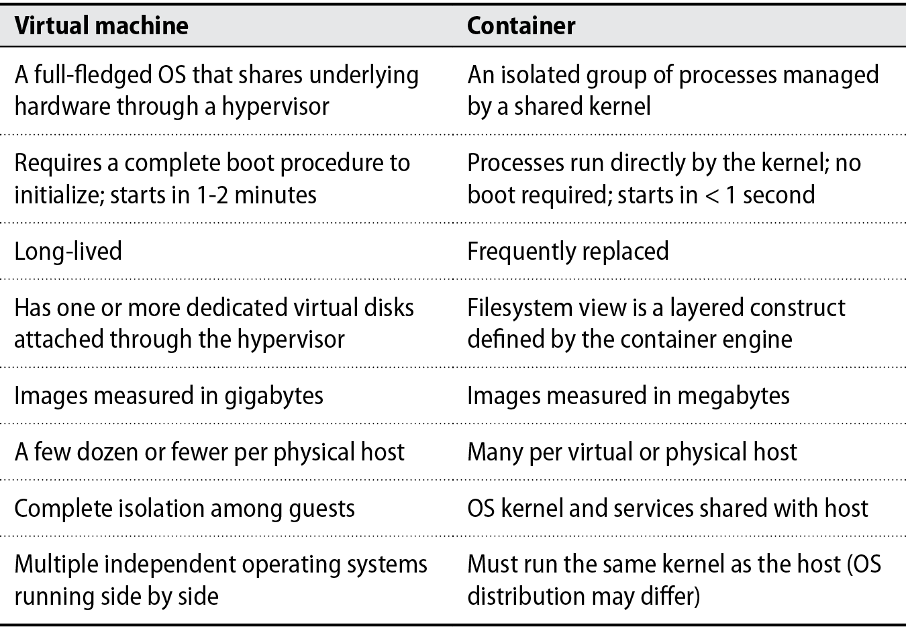

Slide 25
Virtualization with Linux
Xen
Paravirtual Hypervisor
Performance overhead of 0.1%-3.5%
Domains aka Virtual Machine
dom0 = Host
Kernel-based Virtual Machine
Full Virtualization
Paired with QEMU

Slide 26
Proxmox
Open-source hypervisor based on Debian
Server cluster management
Centralized backups
Live migration
High availability
Underlying technologies
Storage - LVM, ZFS, Ceph, Directories
VMs - QEMU/KVM
Containers - LXC
Networking - firewalls, SDNs (software-defined networking)
User management - PAM, PVE database, LDAP, Microsoft AD, OIDC
Web server
Proxmox Backup Server
Proxmox Datacenter Manager

Slide 27
Ganeti
Originally from Google Switzerland
Now maintained by GRNET (Greek Research Network) on Debian
Virtual machine cluster management tool
Disk creation management
Operating system installation
Startup, shutdown, and failover
Uses:
debootstrap
chroot
lvm2
drbd

Slide 28
Singularity / Apptainer
Container platform
Portable
Filesystem stored in an .simg file
Built for HPC
Reproducible Science
Legacy code or systems
https://sylabs.io/

